Slide 1
CubeSat Networks Balancing Energy Consumption with Data Throughput Stephen Ennis Supervisor: Dr. Jonathon Dukes
Notes:
Working title
35-40m incl. demonstration

Slide 2
Introduction
1 - 2 - 3 - 4 - 5
1
Notes:
<5m

Slide 3
Layout
1 - 2 - 3 - 4 - 5
Introduction: Project context, motivations and scope
Prior Art: WSNs, MANETs, SatComms, Missions etc.
Current Design: Protocol design and demonstration
Interim Results: Discussion of key metrics
Further Work: Objectives and expected contributions

Slide 4
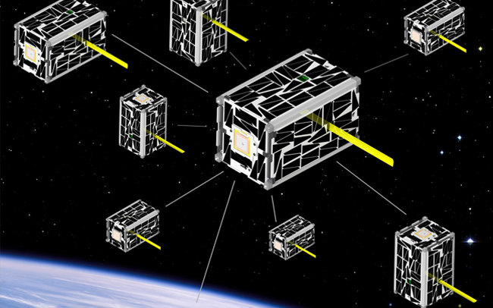
Context
1 - 2 - 3 - 4 - 5
CubeSats: Pseudo-standard platform
Limited power, size and weight
Low cost, highly available and largely open
Sensing is the primary use case
Increased interest in multi-CubeSat missions
Recent missions have tested basic CubeSat inter-satellite communications
Notes:
Increased interest in multi-CS missions: Economical, Technological, Politcal etc.

Slide 5
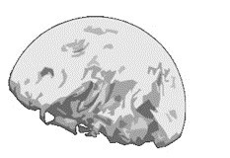
Motivation
1 - 2 - 3 - 4 - 5
Enabling collaborative applications
Limited related work
Untested constellation concepts
High level distributed applications
Low-fidelity simulation/analysis of proposed protocols
Combine mission data, current tech and prior art to produce a simulations of CubeSat networks
Notes:
Collaborative applications: Sensing, Communications, Exploration etc.
Untested constellation concepts: Some upcoming missions, some proposals, some very basic investiagtions
High level distributed applications : Challa/McNair
Low-fidelity simulation/analysis of proposed protocols: Radhakrishnan etc. Survey
Refer back to initial motivation

Slide 6
Scope
1 - 2 - 3 - 4 - 5
Addressing data collection problem
Sensing mission intending to collect as much data as possible
Focusing on MAC and routing protocols
S2G comms with high cost and limited bandwidth
Energy vs. throughput trade-offs
Notes:
Optimization challenge, minimal prior work on developing energy awareness in such scenarios (‘Nodes’ election)
S2G: 500-600km (12kbps) 4W
S2S: Intending to avoid redundant comms but still maintain a somewhat stable mobile network and maximize S2G throughput

Slide 7
Prior Art
1 - 2 - 3 - 4 - 5
2
Notes:
>10m (how to approach)
The really fun part of the presentation
Just an overview intended to illustrate the nature of the works considererd
A quick comment on key works

Slide 8
WSNs
Data collection in wireless sensor networks with mobile elements: A survey – 2011 [1]
Efficient data collection in wireless sensor networks with path-constrained mobile sinks – 2011 [2]
Energy efficiency in wireless sensor networks: A top-down survey – 2014 [3]
1 - 2 - 3 - 4 - 5
Notes:
1: WSN-ME architectures highly relevant mobile DC/R. Routing (well covered), Discovery, Data Transfer (Excellent paper)
2: Considering same tradeoff, mobile sinks, Maximum Amount Shortest Path (MASP), OMNeT, subsink selection, beats shortest-path-tree
3: Energy as a routing metric. Cluster architectures. Cycling. TDMA for Data-gathering application. Cross-layer recommendation
Also: Prediction or not? An energy-efficient framework for clustering-based data collection in wireless sensor networks
Other work mentioning satellite based WSNs exists but few available any great detail

Slide 9
MANETs
Comparative review study of reactive and proactive routing protocols in MANETs – 2010 [4]
VANET Architectures and Protocol Stacks: A Survey – 2011 [5]
Flying Ad-Hoc Networks (FANETs): A Survey – 2013 [6]
1 - 2 - 3 - 4 - 5
Notes:
1: (IEEE) packet loss, delay, jitter, bandwidth, (DREAM) protocol (Pr), DSR praised, CBRP might be next best, stick with reactive. Would like more depth.
2: (Springer Book) V2V/V2I, focus MAC/Net+, Mobile IPv6 / 802.11 stack based, far less resource constrained, Car to Car Consortium
3: (Ad Hoc Networks) A FANET cross-layer architecture (IMAC-UAV . DOLSR) Cooperative Autonomous Reconfigurable UAV Swarm (CARUS) similar, predictable movement, Power consumption and network lifetime
Cross layer design for mobile Ad-Hoc Unmanned Aerial Vehicle communication networks (From 3) E2E++ Directional antennae
A lot of recent MANET work focued on security

Slide 10
CubeSat Communications
Inter-satellite links for CubeSats - 2013 [7]
Optimal multiple access protocol for inter-satellite communication in small satellite systems – 2014 [8] (CubeMac)
Survey of Inter-satellite Communication for Small Satellite Systems: Physical Layer to Network Layer View – 2016 [9]
1 - 2 - 3 - 4 - 5
Notes:
1: (IEEE) Top to bottom view of CS comm systems most focus on physical aspects, based on OLFAR. CDMA/OQPSK proposed.
2: (4S) Mirroring parameters. TDMA centric etc. TP/Access/E2E, DS-CDMA, fixed slot assignment etc. extend future work. 95% TP.
3: (IEEE) Cross-layer optimization and adaptivitiy emphasized. LDMA, handover and route discovery.
"The current state of the art for small satellite communications is a one hop link between satellite and ground stations"
OLFAR: orbiting low frequency array (swarm concept)

Slide 11
Missions of Note
Nodes: A Flight Demonstration of Networked Spacecraft Command and Control – 2016 [10]
The STU-2 CubeSat Mission and In-Orbit Test Results – 2016 [11]
Battery-Aware Scheduling in Low Orbit: The GomX–3 Case – 2016 [12]
1 - 2 - 3 - 4 - 5
Notes:
1: (NASA) EDSN, Custom Cap/Lt protocol schedule negotiation and Cap election
2: (CNSA TW-1) Gamalink
3: (ESA) Rather sophisticated model-based prediction/heuristics alogrithm for schedule creation, A-Sync proposed, Mention the balance of power and data budgets
No coincidence that all of these happened to be published in 2016

Slide 12
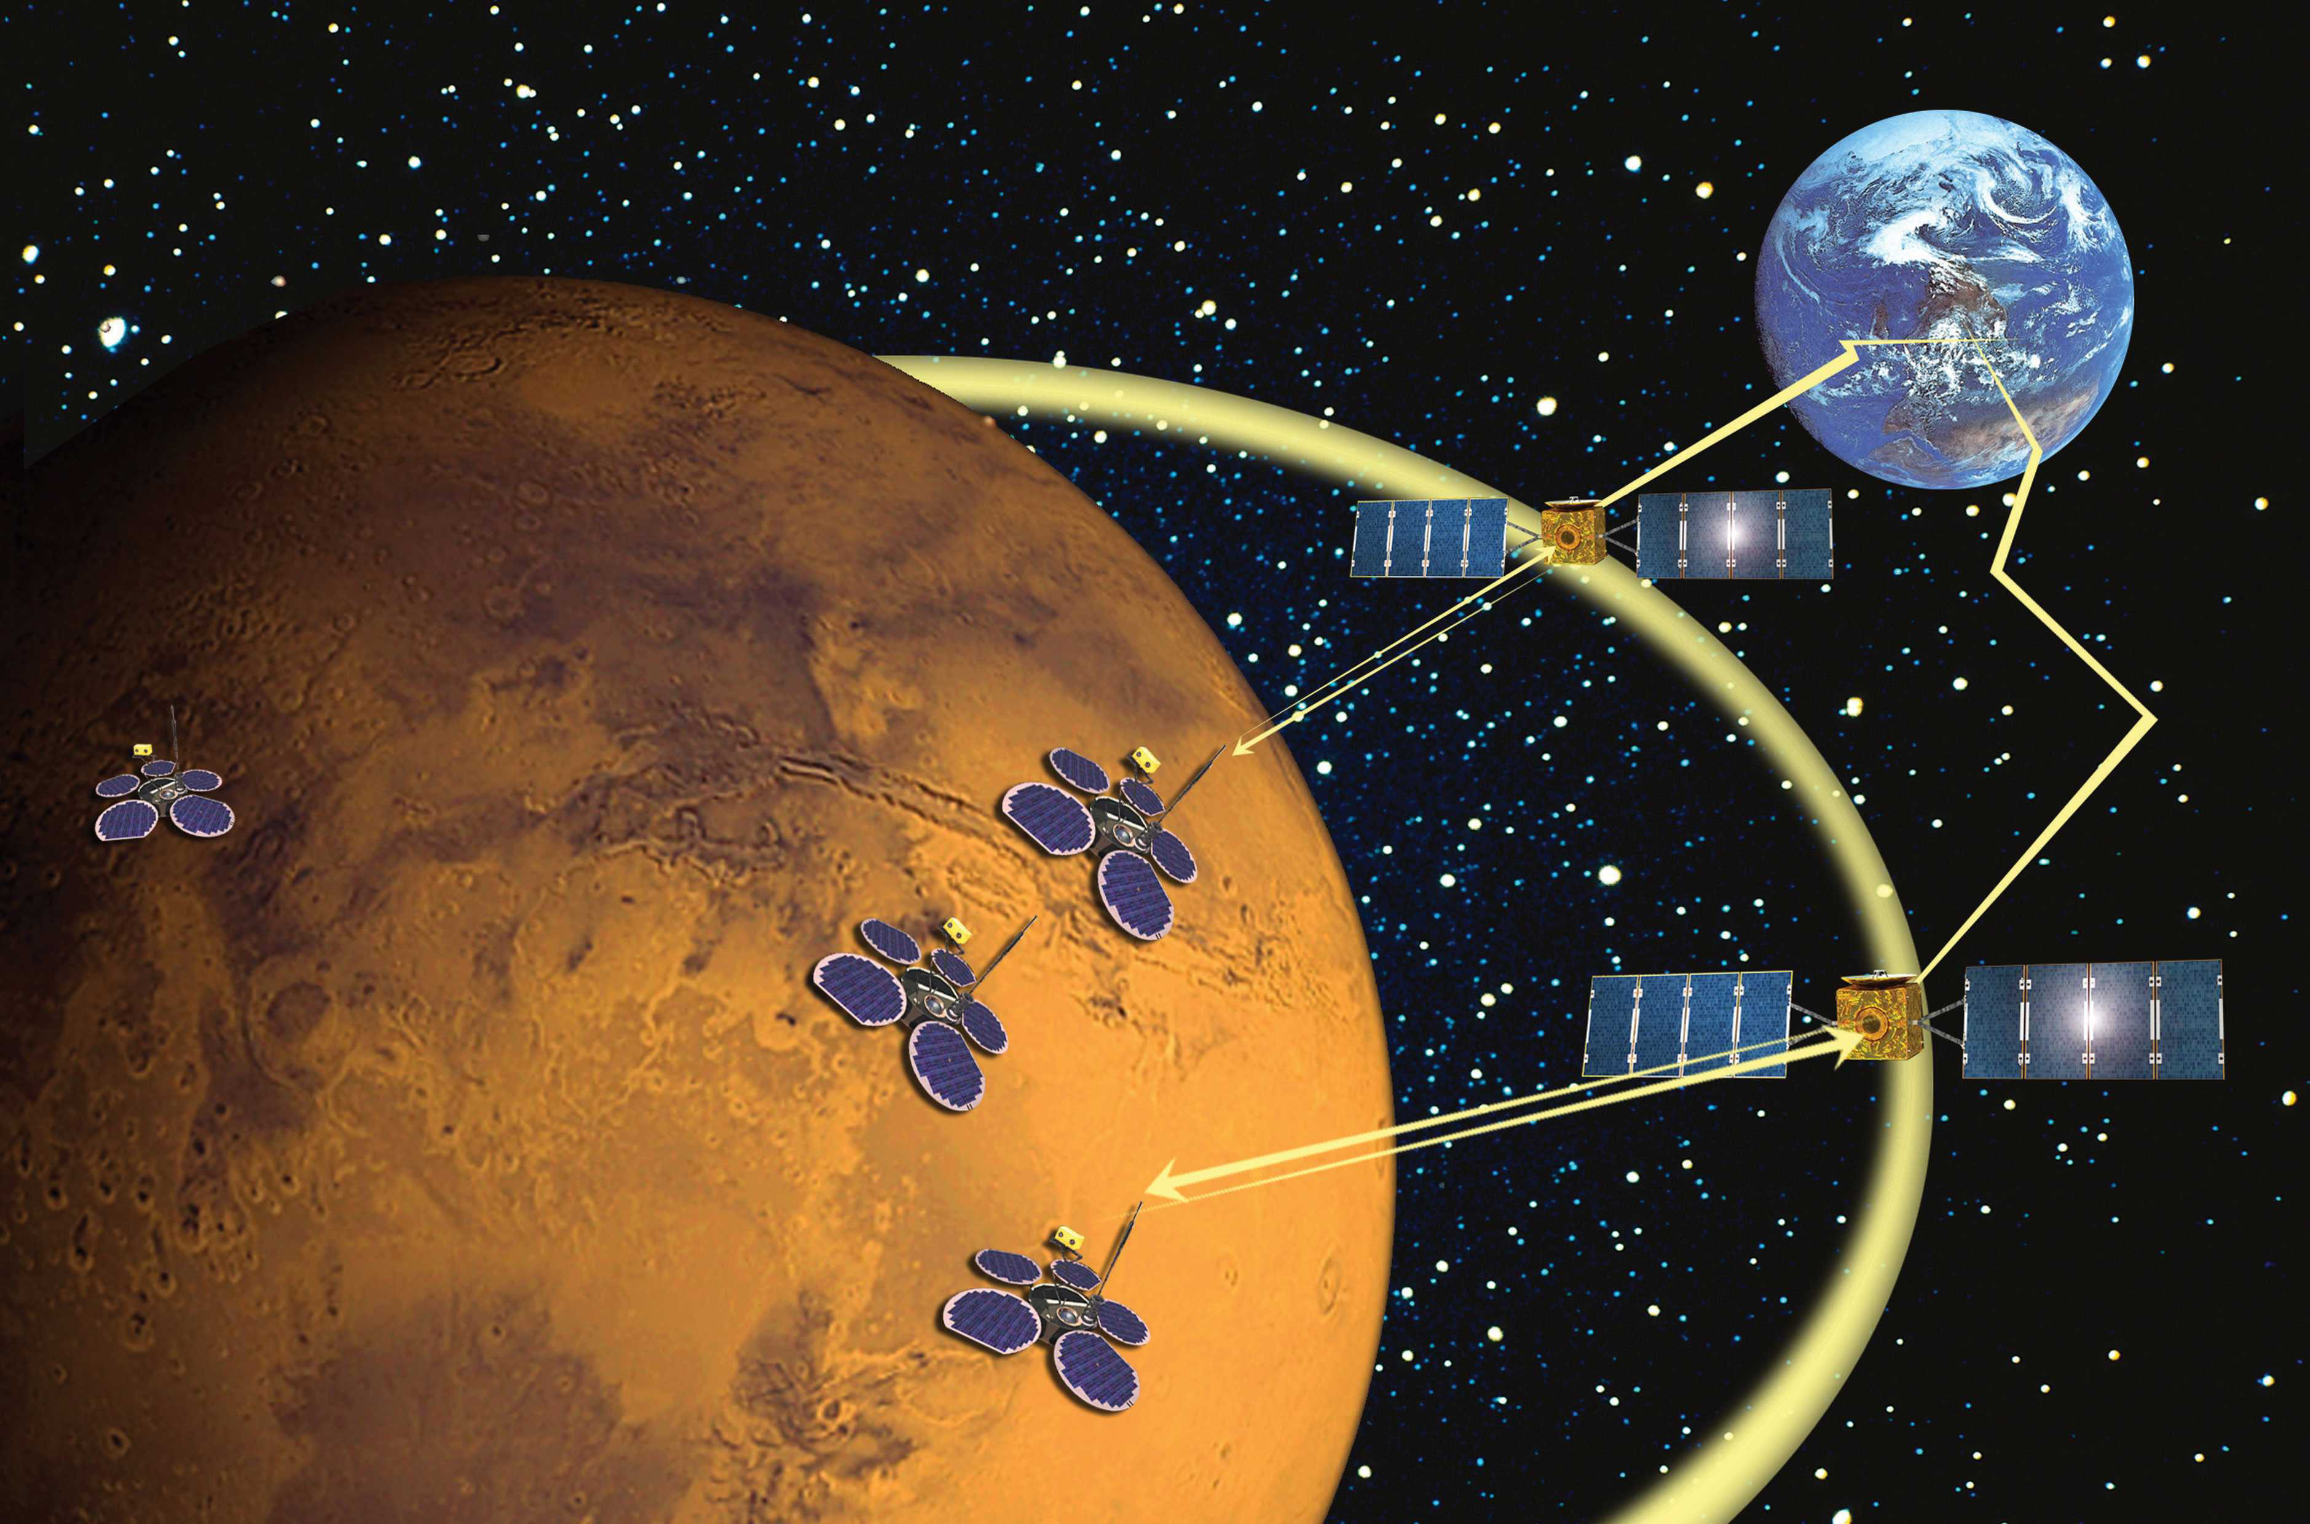
Other Areas of Note
Delay Tolerant Networking
AODV and friends
RPL
GNSS Clock Synchronization
1 - 2 - 3 - 4 - 5
Notes:
1: Delay-and disruption-tolerant networking (DTN): an alternative solution for future satellite networking applications (Farrell)
2: Performance comparison of AODV, DSDV, OLSR and DSR routing protocols in mobile ad hoc networks (Many such papers exist)
3: RPL in a nutshell: A survey (A rather large nutshell)
4: Synchronization and syntonization of formation flying cubesats using the namuru V3. 2 spaceborne GPS receiver

Slide 13
Current Design
1 - 2 - 3 - 4 - 5
3
Notes:
10m (5m CubeMac / 5m Demo)

Slide 14
Quick Timeline
1 - 2 - 3 - 4 - 5
Began work with Dr. Farrell – Week 1M
Change of supervisor to Dr. Dukes – 8M
Reassessment/Scoping – 8M : 11M
Dropped dyanmics modelling & began work with NS-3 – 12M
Switched to OMNeT++ - 2H
Modelling prior art MAC protocol – 3H : 8H
Introducing ground station – 8H : Present

Slide 15
CubeMac
Cluster based hybrid TDMA/CDMA scheme
Cluster consists of one Master (M) and n Slaves (S)
Masters use TDMA for all communications
Slaves only communicate with their cluster master
Slaves use CDMA within dedicated “uplink” slot
Fixed time slots, slot assignment and cluster configurations
1 - 2 - 3 - 4 - 5
Notes:
Besides high-level work on the project the bulk of the work thus far has gone into replicating the prior work of Radhakrishnan et al.
Authors speak of reclustering/master election but give no details on the approach taken
Hopefully moving away from fixed approach

Slide 16
CubeMac
1
2
S
S
M
M
S
S
2
1
s
1 - 2 - 3 - 4 - 5

Slide 17
Demonstration
1 - 2 - 3 - 4 - 5

Slide 18
Interim Results
1 - 2 - 3 - 4 - 5
4
Notes:
5m

Slide 19
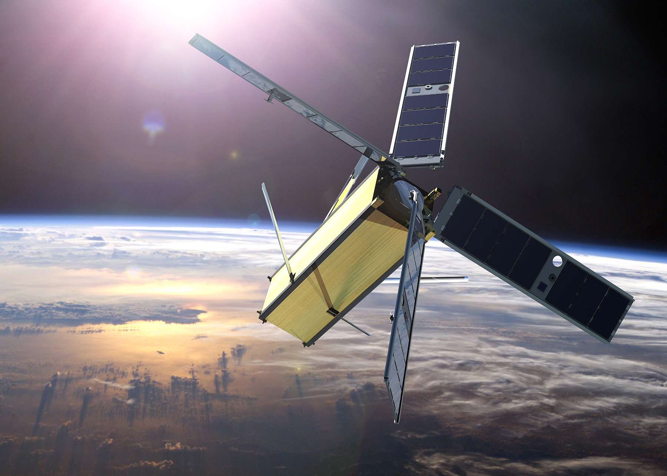
Key Metrics
S2G Throughtput
End-to-end delay
MAC access delay
Energy consumption
Scenario: 100s, 4 Clusters, 2 Slave per clusters, 1 Ground,
1 - 2 - 3 - 4 - 5
Notes:
1: Given
2: Ramifications for limited mission schedules and reliability
3: The amount of time packets spend waiting on MAC queue
4: State based

Slide 20
1 - 2 - 3 - 4 - 5
Notes:
As packet size increases less packets sent per slot
256 approaches the largests packet size that a slot of 100ms can handle can handle

Slide 21
1 - 2 - 3 - 4 - 5
Notes:
Across all runs
Packets reaching ground in under approx 2 frames as expected (Each frame = 0.6s)

Slide 22
1 - 2 - 3 - 4 - 5
Notes:
Across all runs

Slide 23
1 - 2 - 3 - 4 - 5
Notes:
Over 100s period

Slide 24
1 - 2 - 3 - 4 - 5
Notes:
Zero recharge

Slide 25
Further Work
1 - 2 - 3 - 4 - 5
5
Notes:
<5m

Slide 26
Objectives
Implement faithful ground station
Address flaws in CubeMac
Examine optimal routing approaches
Introduce energy awareness
Stick the landing
1 - 2 - 3 - 4 - 5

Slide 27
Expected Contributions
Analysis of hybrid TDMA/CDMA and routing schemes considering both throughput and energy consumption
Assessment and synthesis of varied prior art
Open-source simulation for LEO SmallSat communications
Opportunities to model sophisticated energy schemes and applications
Design that reflects both missions and research
1 - 2 - 3 - 4 - 5

Slide 28
Thank You

Slide 29
Questions
?

Slide 30
References
[1] M. Di Francesco, S. K. Das, and G. Anastasi, "Data collection in wireless sensor networks with mobile elements: A survey," ACM Transactions on Sensor Networks (TOSN), vol. 8, p. 7, 2011.
[2] S. Gao, H. Zhang, and S. K. Das, "Efficient data collection in wireless sensor networks with path-constrained mobile sinks," IEEE Transactions on Mobile Computing, vol. 10, pp. 592-608, 2011.
[3] T. Rault, A. Bouabdallah, and Y. Challal, "Energy efficiency in wireless sensor networks: A top-down survey," Computer Networks, vol. 67, pp. 104-122, 2014.
[4] S. Mohseni, R. Hassan, A. Patel, and R. Razali, "Comparative review study of reactive and proactive routing protocols in MANETs," in Digital ecosystems and technologies (DEST), 2010 4th IEEE international conference on, 2010, pp. 304-309.
[5] S. A. Mohammad, A. Rasheed, and A. Qayyum, "VANET architectures and protocol stacks: a survey," in International Workshop on Communication Technologies for Vehicles, 2011, pp. 95-105.
[6] I. Bekmezci, O. K. Sahingoz, and Ş. Temel, "Flying ad-hoc networks (FANETs): A survey," Ad Hoc Networks, vol. 11, pp. 1254-1270, 2013.
[7] A. Budianu, T. J. W. Castro, A. Meijerink, and M. J. Bentum, "Inter-satellite links for cubesats," in Aerospace Conference, 2013 IEEE, 2013, pp. 1-10.
[8] R. Radhakrishnan, W. W. Edmonson, F. Afghah, J. Chenou, R. M. Rodriguez-Osorio, and Q.-A. Zeng, "Optimal multiple access protocol for inter-satellite communication in small satellite systems," in 4S Small Satellite Systems and Services Symposium, 2014.
[9] R. Radhakrishnan, W. W. Edmonson, F. Afghah, R. M. Rodriguez-Osorio, F. Pinto, and S. C. Burleigh, "Survey of Inter-satellite Communication for Small Satellite Systems: Physical Layer to Network Layer View," IEEE Communications Surveys & Tutorials, vol. 18, pp. 2442-2473, 2016.
[10] J. Hanson, A. G. Luna, R. DeRosee, K. Oyadomari, J. Wolfe, W. Attai, et al., "Nodes: A Flight Demonstration of Networked Spacecraft Command and Control," 2016.
[11] S. Wu, W. Chen, and C. Chao, "The STU-2 CubeSat Mission and In-Orbit Test Results," 2016.
[12] M. Bisgaard, D. Gerhardt, H. Hermanns, J. Krčál, G. Nies, and M. Stenger, "Battery-Aware Scheduling in Low Orbit: The GomX–3 Case," in FM 2016: Formal Methods: 21st International Symposium, Limassol, Cyprus, November 9-11, 2016, Proceedings 21, 2016, pp. 559-576.

